Slide 1



CONCEAL WEAPON DETECTION
FINE TUNED MODEL YOLOV11
1

Slide 2
ABOUT US
HUSSAIN ALI FA21-BCS-066
ALI SHAN FA21-BCS-080
2

Slide 3
TABLE OF CONTENTS
Key features
Conclusion
Code
Introduction
Problem
Objectives
Methodology
Results
User Interface
3

Slide 4
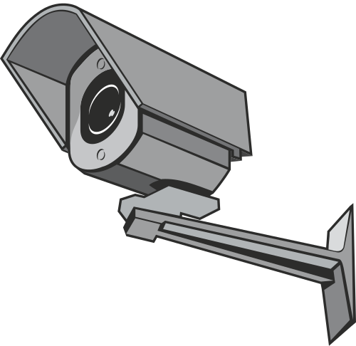
INTRODUCTION
This project focuses on detecting pistols in thermal images using a fine-tuned YOLOv11n model. By leveraging the advantages of thermal imaging and the speed of YOLOv11, the system aims to provide accurate and real-time weapon detection for enhanced security in low-visibility environments. The model is trained on a custom dataset of thermal pistol images to ensure high precision and recall in practical scenarios.
4

Slide 5
Problem
Conventional weapon detection struggles in low visibility and relies heavily on manual monitoring. This project aims to solve that by using a fine-tuned YOLOv11 model to detect pistols in thermal images with high accuracy and real-time performance.
5

Slide 6

Objectives
Develop a real-time pistol detection system
Use a fine-tuned YOLOv11 model trained on thermal images
Ensure high precision and recall
Maintain performance in low-light or obscured visibility
conditions
6

Slide 7
METHODOLOGY
Qualitative
Quantitative
Collected and annotated a custom thermal pistol image dataset.
Fine-tuned the lightweight YOLOv11n model on this dataset.
Trained and validated the model for accurate pistol detection.
Tested the model on new images and visualized detection results.
Dataset split: 80% train, 10% validation, 10% test.
Trained for 100 epochs with 640×640 image size.
Achieved metrics:
mAP50-95: 0.7281
Precision: 1.0000
Recall: 0.9964
F1 Score: 0.9982
7

Slide 8
KEY FEATURES
Real-time thermal weapon detection
High precision and recall
Lightweight and efficient model (YOLOv11n)
Easy to train and deploy
Robust performance in low-light and obscured environments
Works on custom thermal image datasets
Compatible with surveillance camera feeds
Visual output with bounding boxes and confidence scores
8

Slide 9

CONCLUSION
This project successfully demonstrated the use of a fine-tuned YOLOv11n model for real-time thermal pistol detection. The model achieved high precision and recall, proving its effectiveness in low-light and obscured environments.
9

Slide 10
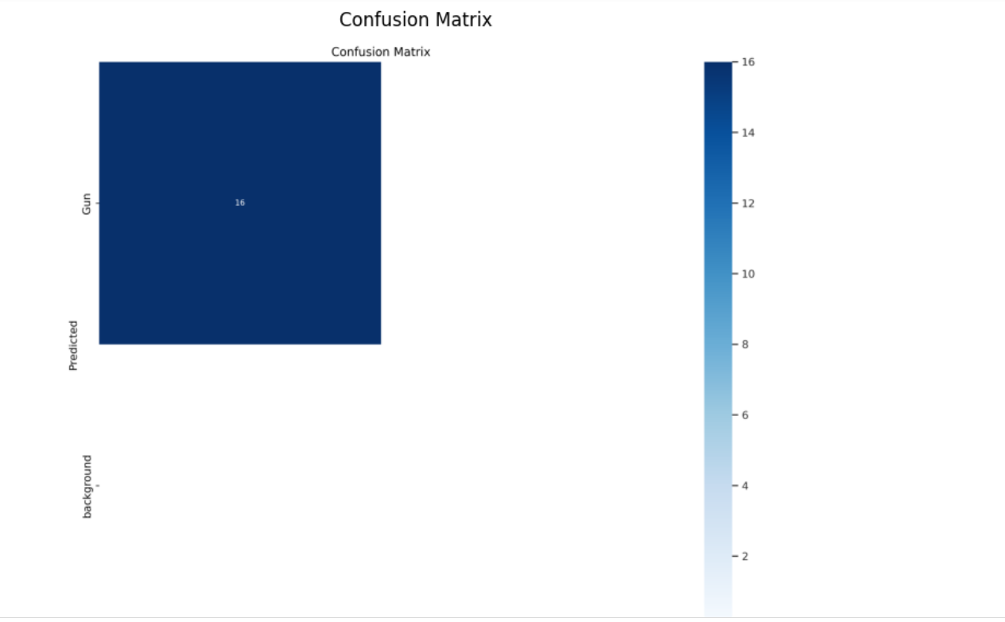
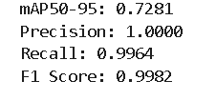
RESULTS
10

Slide 11
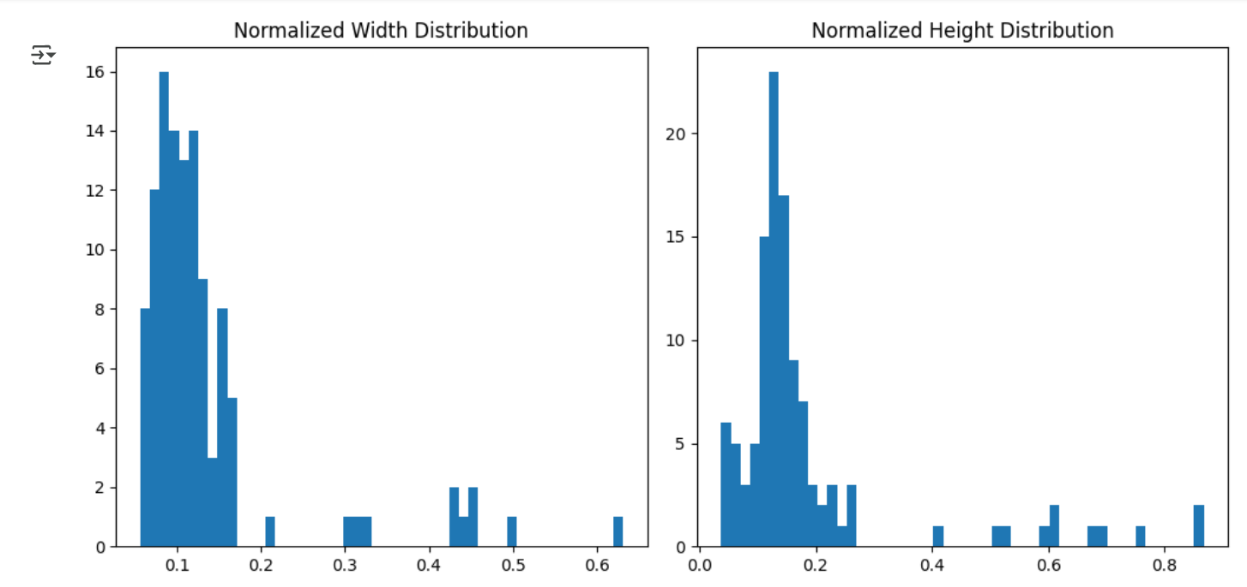
RESULTS
11

Slide 12
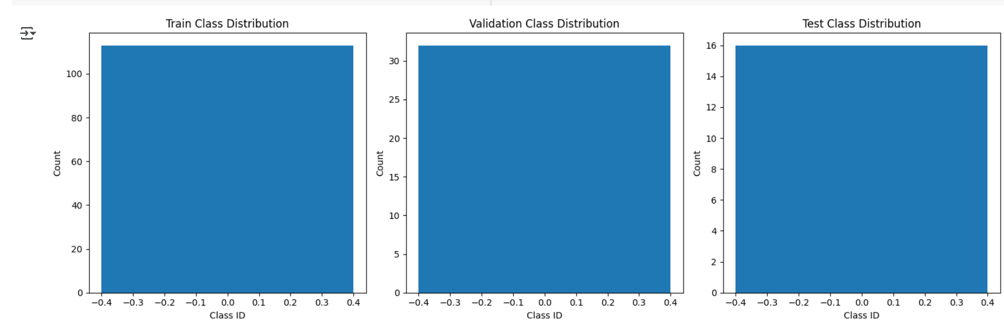
--CONTINUED
12

Slide 13
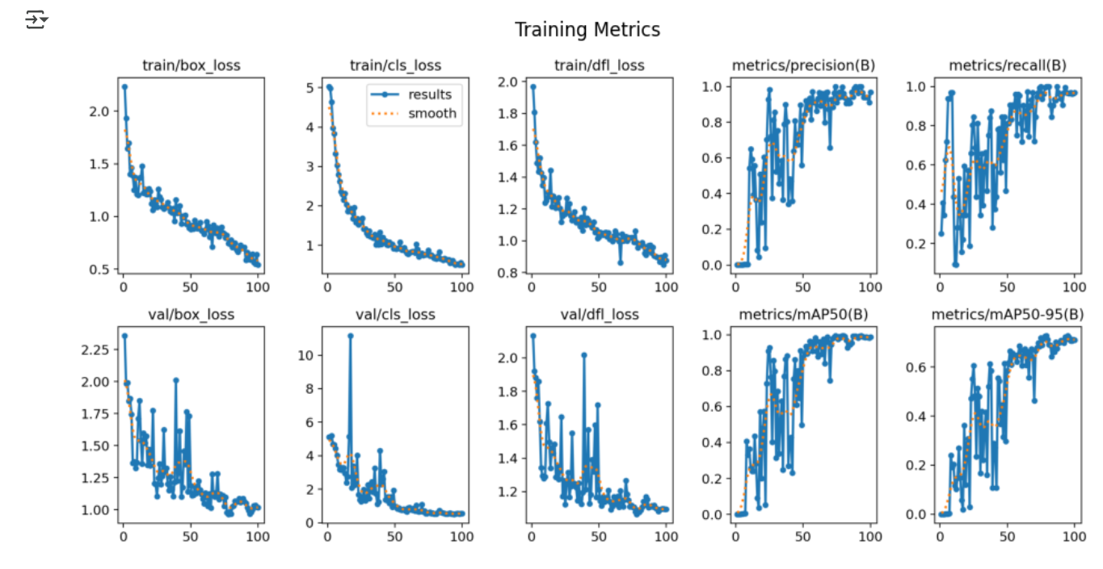
--CONTINUED
13

Slide 14
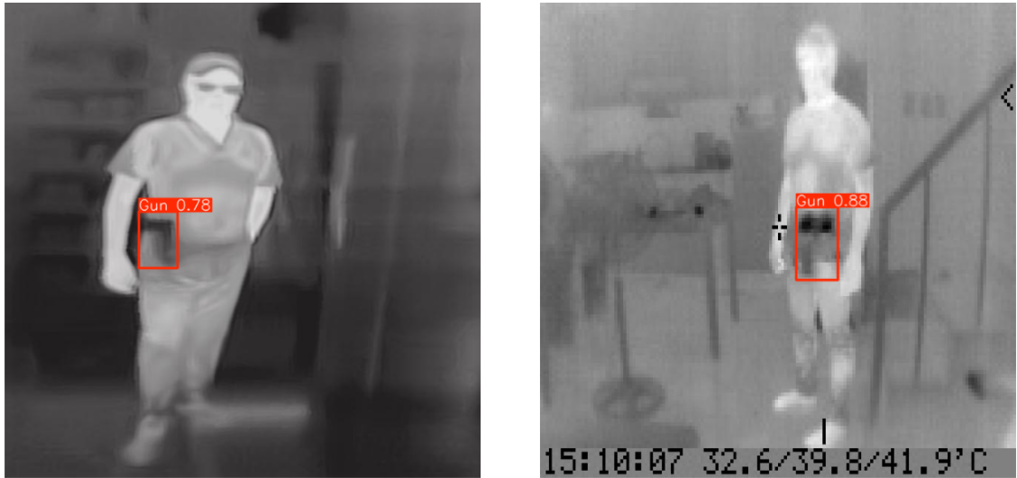
--CONTINUED
14

Slide 15
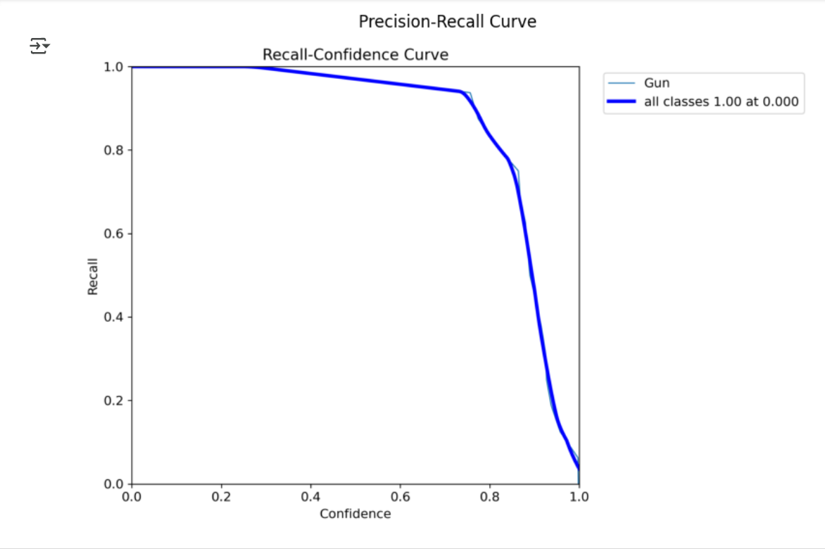
--CONTINUED
15

Slide 16
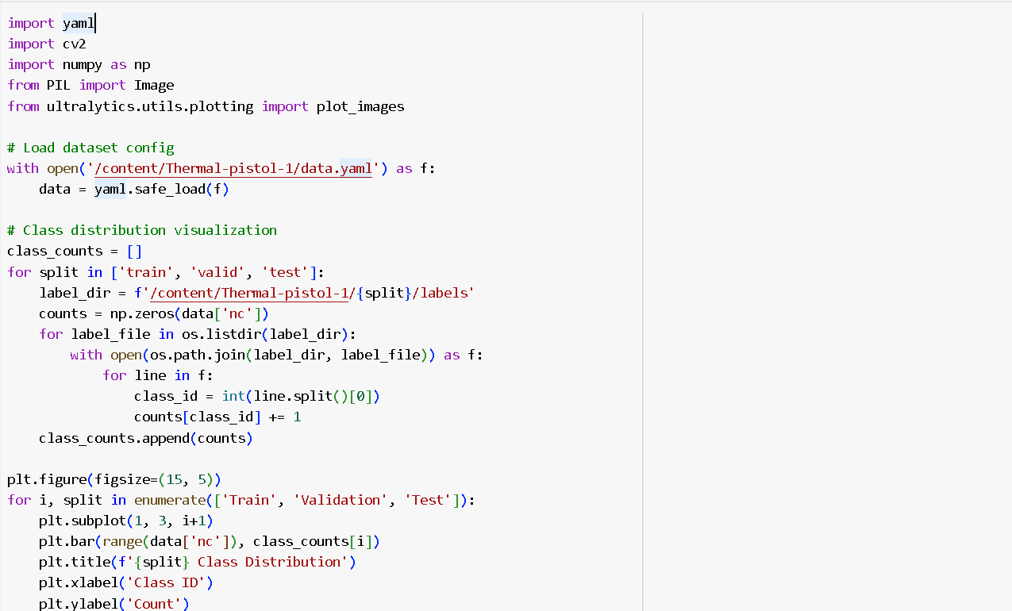
CODE
16

Slide 17
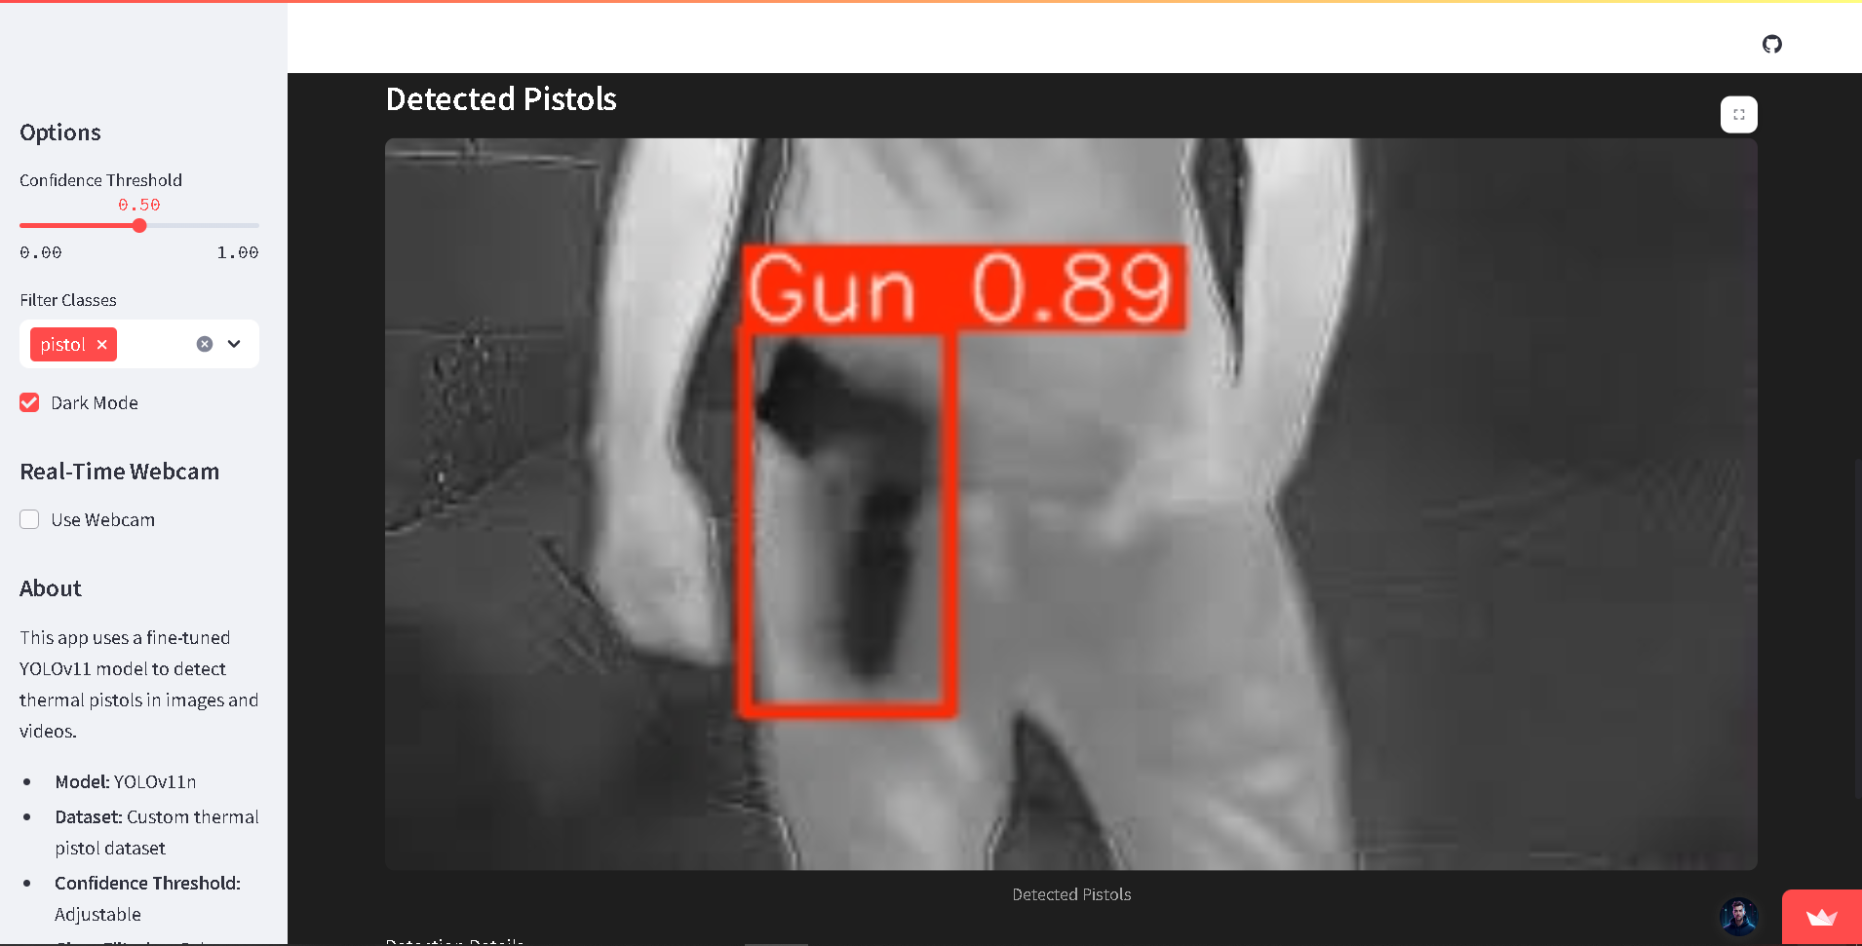
USER INTERFACE
17

Slide 18

Thank You
For your attention
18

